Slide 1

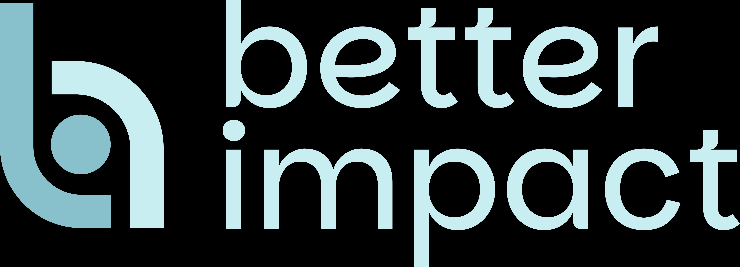
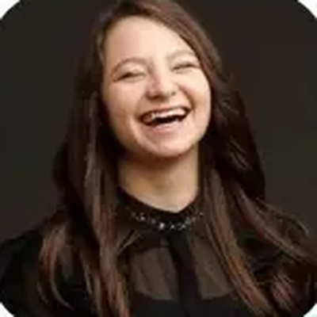
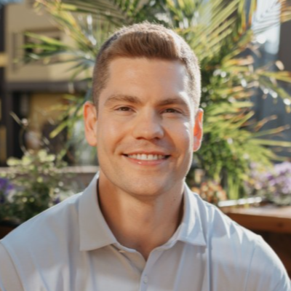
Volunteer Strategy 2027:
LIVE DEMINAR · PART 1 OF 2
How Leaders are Connecting Volunteerism to Their Organization’s Mission by Using Better Impact
Addie Whetro
Julian Eiers
Volunteer Tech Advisors Lead
Senior Account Executive
November 4, 2026 · Questions welcome in the chat · Stay to the end for an attendee-only offer
Notes:
ADDIE (about 60 seconds). Welcome everyone in by name as they arrive in the chat; ask them to drop where they're joining from and what kind of organization they lead volunteers for. Intros, about 45 seconds each: Addie first, then "Julian, over to you." Julian introduces himself and hands back. Housekeeping in three beats: the chat is open the whole time and Addie is watching it; the recording goes to every registrant; live attendees earn a certificate toward PDUs. Plant the open loop: "Stick with us to the end, because we have something for today's attendees that isn't available anywhere else." Don't reveal the offer yet. Drop the booking link in the chat once now.

Slide 2
What we’ll cover together
ABOUT THIS SERIES
1
How the volunteer-to-donor connection is often missed, and how to bridge the gap
2
Why the ROI on investing in Volunteer Engagement is more than just tracked hours
3
How leaders are using Better Impact to support organizational mission and community outcomes, with a live look at everyday workflows
Notes:
ADDIE (about 45 seconds). Set the frame for the whole series. "Here's what this two-part series is about. First, the volunteer-to-donor connection: why it's so often missed and how to bridge it. Second, why the return on investing in volunteer engagement is much bigger than the hours you track. And third, the part I think you'll like most: a live look at how leaders are actually doing this in Better Impact, day to day. Julian's going to show you that in a few minutes. Let's start with the first one, because the number surprises most people."

Slide 3
Your volunteers are already donors
THE OVERLOOKED PIPELINE
+32%
Increase in donations after targeted recruitment and encouragement campaigns
79%
Randomized field experiments, 149,000+ individuals – Marketing Letters (Springer)
50%
of volunteers say they give more after volunteering
CCS Fundraising
of volunteers also donate to the organization where they serve
69%
of high-net-worth donors volunteer as a way to create impact
CCS Fundraising, via The Chronicle of Philanthropy
CCS Fundraising
Notes:
ADDIE (about 90 seconds). Open with a question before the reveal: "Gut check in the chat: what percentage of your volunteers do you think also give financially?" Let a few answers land, then point to 79%. "Nearly four out of five." Land the line: "When you build your volunteer pool, you build your donor pool." Then the proof, one breath each: organizations on Better Impact grow their volunteer base 6.2 times on average in their first two years; half of volunteers say they give more after volunteering, because they've seen the impact up close; and 69% of high-net-worth donors volunteer as a way to create impact, so your volunteer roster may already include your next major donor. Hand off: "Julian's going to take it from here." Use 79% consistently; don't mix in 80% or 85%.

Slide 4
Two moments turn a volunteer into a lifelong supporter
WHERE THE PIPELINE IS BUILT
01
02
Recruitment: the first yes
Engagement: every yes after
Fast, mobile-friendly sign-up and a smooth application turn interest into a first shift.
Recognition, mission updates, and the next opportunity keep volunteers close to your impact.
Live in Volunteer Impact →
with Julian Eiers
Notes:
JULIAN (about 30 seconds), continuing from slide 4. "So if volunteers are the pipeline, it gets built in two moments. The first yes, which is recruitment. And every yes after, which is engagement. Rather than talk about it, let me show you what that looks like day to day." Then share screen on the public opportunity page. Addie keeps the booking link pinned in the chat during the demo.

Slide 5
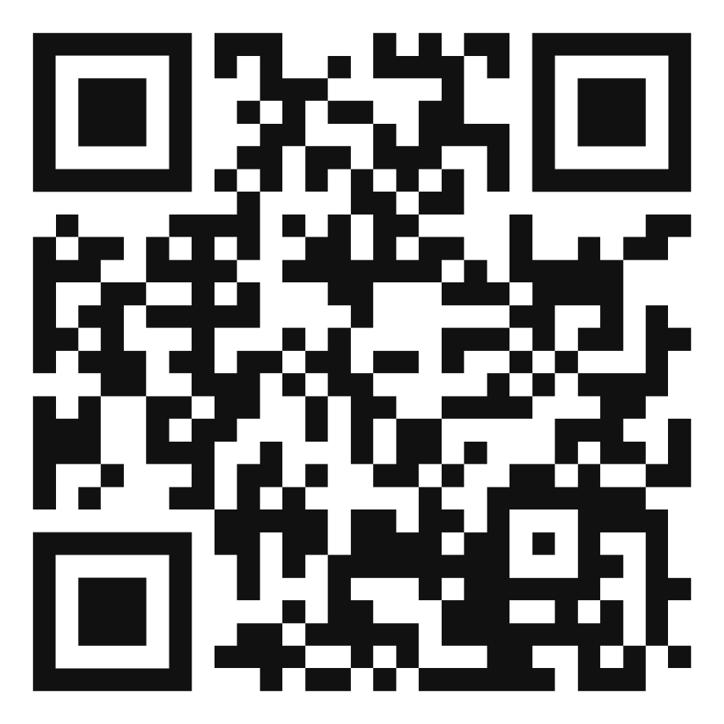
Book your demo today and get 2 months free
FOR TODAY’S ATTENDEES
✓ A walkthrough built around your program
✓ A custom 2027 strategy recommendation
Offer ends November 30
Link is in the chat too
Scan to book
New Better Impact customers. Book through this link by November 30, 2026.
Notes:
JULIAN: the big finale (about 90 seconds). Stop sharing the product, bring this slide up, and pause for a beat before speaking. "Addie promised something at the top, so here it is. Everyone who books a demo through this link gets two months free. Publicly, the Giving Tuesday offer is one month. This one is just for the people in this room." Then the live-scan move: "Do me a favor right now: grab your phone, open the camera, and point it at the screen. I'll wait." Actually wait 5 to 7 seconds in silence. "If you're on your phone already, the link is in the chat." Then the deadline, calmly: "It runs through November 30, so you're locked in before Giving Tuesday." Hand to Addie for the close.

Slide 6
Three steps from here
WHAT HAPPENS NEXT
1
2
3
Scan and book
Share your program
Get your plan
Pick a time, right from your phone.
Your volunteers, goals, and tools.
A tailored plan, 2 months free locked in.
Thank you for joining us
Part 2 · Tuesday, December 8 · 1:00 pm EST
Notes:
ADDIE: the close (2 to 3 minutes). Keep this slide up until the very end so the QR stays on screen. Walk the three steps in one breath each: scan and book, share your program, get your plan. Read two or three names from the chat who've booked or asked a question: "I see a few of you already booked, thank you." Restate the offer and deadline once: "Two months free, through this link, through November 30." Remind them the recording goes to every registrant, and the offer applies to all registrants, so they can forward it to their director or development lead. Tease Part 2 on December 8. Final line: "Thank you for everything you do for your volunteers. We'll see you in December." Drop the link in the chat one last time before ending.

