Slide 1



LIVE WEBINAR
Better Together
SEEK Volunteer + Better Impact live demo
Thursday 29 October 2026 · 1:30pm AEDT
Welcome! We’ll be starting in just a few minutes.
Notes:
Holding slide: display as attendees join. Start on time; a quick welcome and housekeeping (recording, Q&A) before moving on.

Slide 2
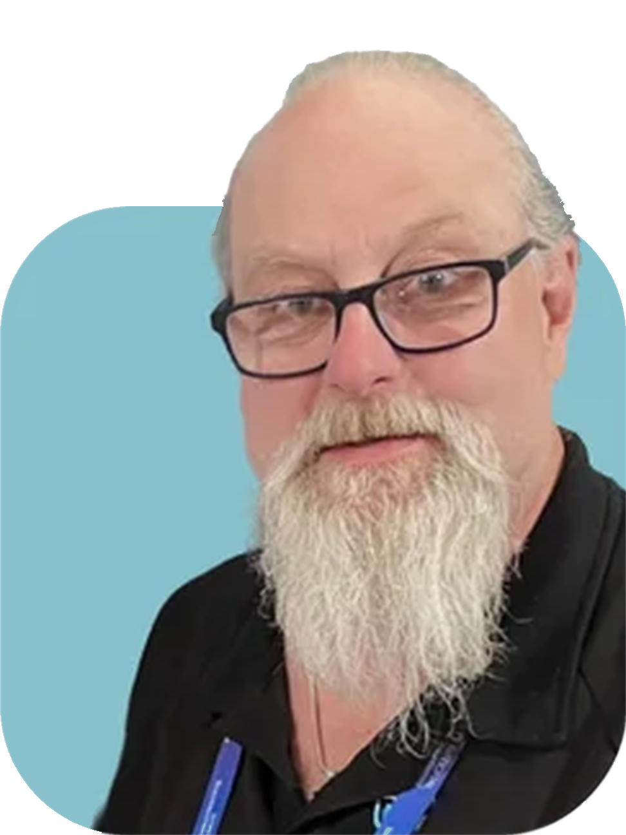
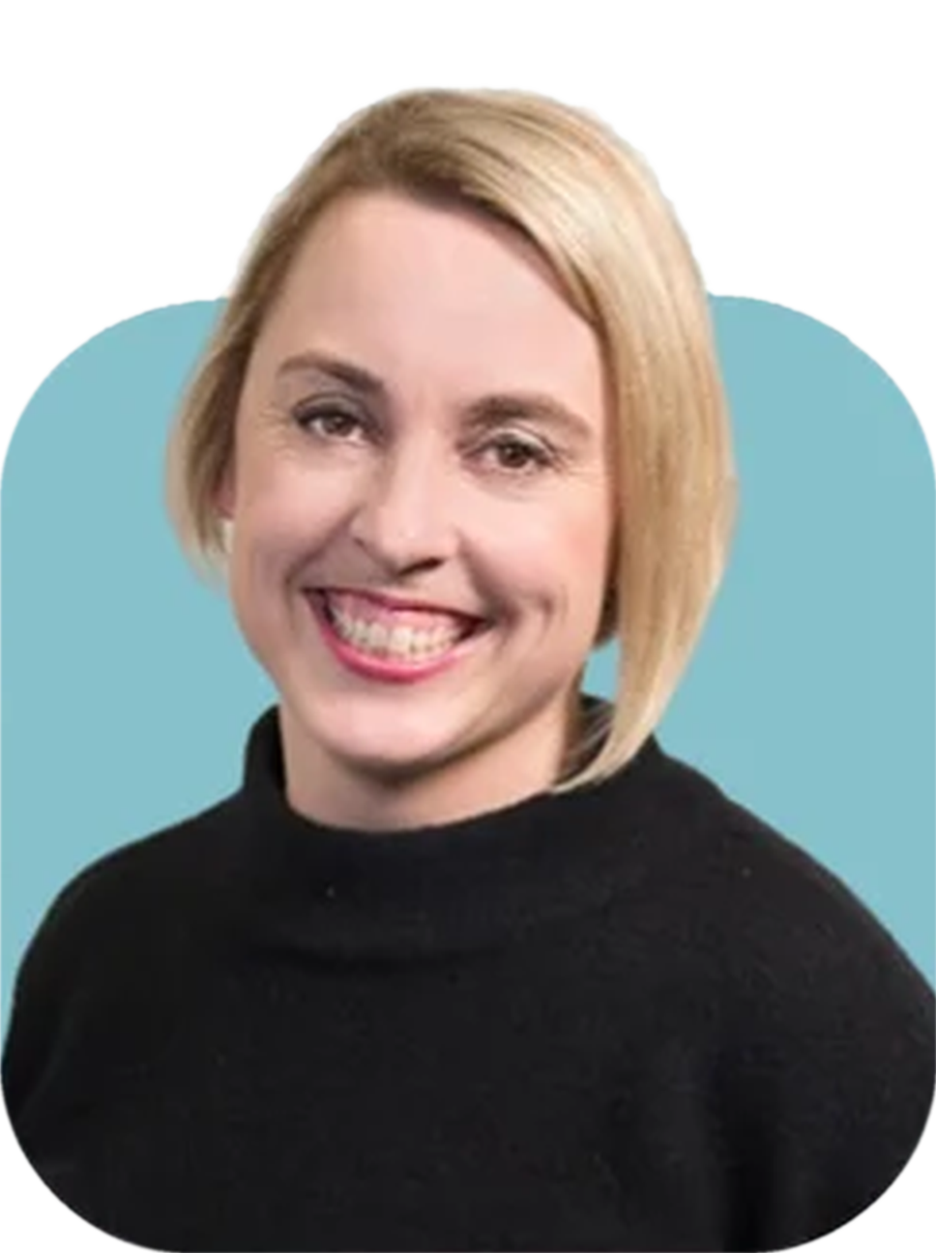


Meet today’s presenters
YOUR PRESENTERS
Andy Fryar
Katrina Hudson
Regional Director – Australia & NZ
Senior Manager, SEEK Volunteer
Notes:
Andy introduces himself, then Katrina. Keep each intro to about 30 seconds.

Slide 3
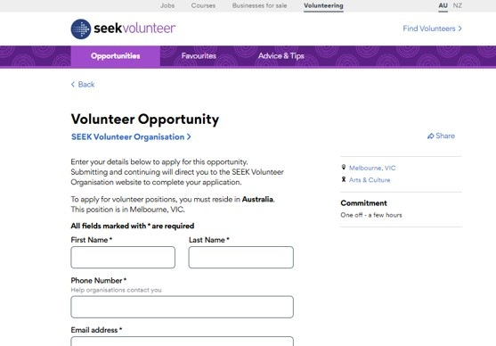
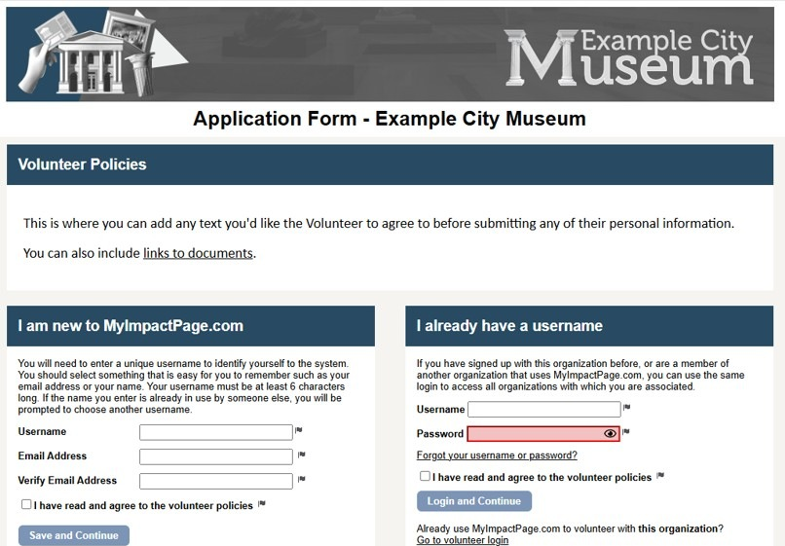





Today: three steps across two systems
CURRENT STATE
Subject: Now apply on Better Impact to complete your application
1
Apply for a SEEK Volunteer role
2
Receive an email invitation
3
Complete Better Impact registration
The volunteer submits an application on SEEK Volunteer.
The organisation emails a link to continue and complete the application.
The volunteer creates or logs in to an account and completes the form.
Drop-off risk: SEEK Volunteer application → email invitation → Better Impact registration
Notes:
Walk through today's process. The gap between step 1 and step 3 depends on someone sending, and the volunteer acting on, an email invitation, which is where applicants drop off.

Slide 4
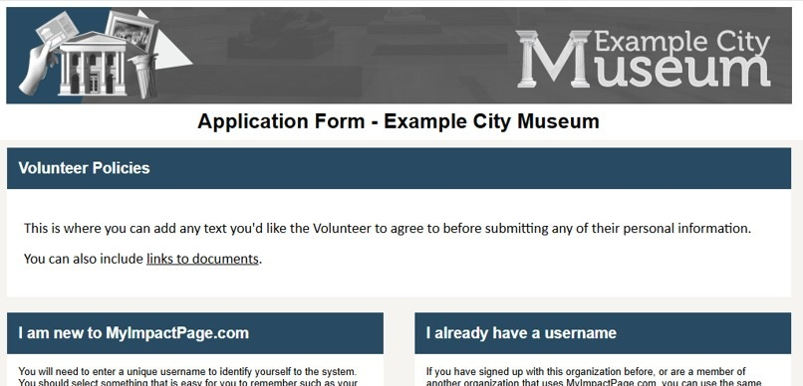

Soon: one connected journey
FUTURE STATE
Redirected straight to Better Impact
1
Apply for a SEEK Volunteer role
2
Complete Better Impact registration
The volunteer submits an application on SEEK Volunteer.
The volunteer creates or logs in to an account and completes the form.
One connected journey: SEEK Volunteer application → Better Impact registration
Notes:
With the integration, the email invitation step disappears: volunteers are redirected to your Better Impact form as soon as they apply on SEEK Volunteer.

Slide 5


So how does this all work?
SEEING IT IN ACTION
Live demonstration
with Katrina Hudson, SEEK Volunteer
Notes:
Andy throws to Katrina for the live demonstration.

Slide 6
Next Steps
Google Form > Seek Volunteer link set-up
Notes:
Andy throws to Katrina for the live demonstration.

Slide 7

Any questions?
Ask away. We’ll answer as many as we can live.
Notes:
Open the floor. Read questions aloud before answering so they are captured in the recording.

Slide 8

Thank you for joining us
STAY IN TOUCH
Andy Fryar
Katrina Hudson
Regional Director – Australia & NZ
Senior Manager, SEEK Volunteer
Andy@betterimpact.com.au
khudson@seek.com.au
Didier@betterimpact.com.au
0423 602 803
volunteer.com.au
www.betterimpact.com.au/meet-with-didier
betterimpact.com.au
Every registrant will receive the recording, so feel free to share it with your team.
Notes:
Thank attendees, point to contact details, and remind them the recording will be sent to all registrants.

